Slide 1

Vendor Performance Analysis
Sales, Profitability & Vendor Efficiency Overview
PREPARED BY DATA ANALYTICS TEAM

Slide 2
EXECUTIVE SUMMARY
Business Performance Overview
Strong Revenue
Vendor Concentration
Efficiency Concerns
Total sales reached $441.41M with healthy 38.72% profit margin, demonstrating solid market performance.
Top 10 vendors contribute 65.69% of purchases, indicating significant dependency on key suppliers.
Low-performing vendors and $2.71M in unsold capital require strategic attention and optimization.

Slide 3
Key Business Metrics
$441M
$307M
$134M
38.72%
Total Sales
Total Purchase
Gross Profit
Profit Margin
Strong revenue performance
Procurement investment
Healthy margin generation
Above-average profitability
$2.71M
Unsold Capital
Inventory optimization needed
These metrics demonstrate strong operational performance with robust profitability. However, unsold capital represents an opportunity to improve inventory efficiency and working capital management.

Slide 4
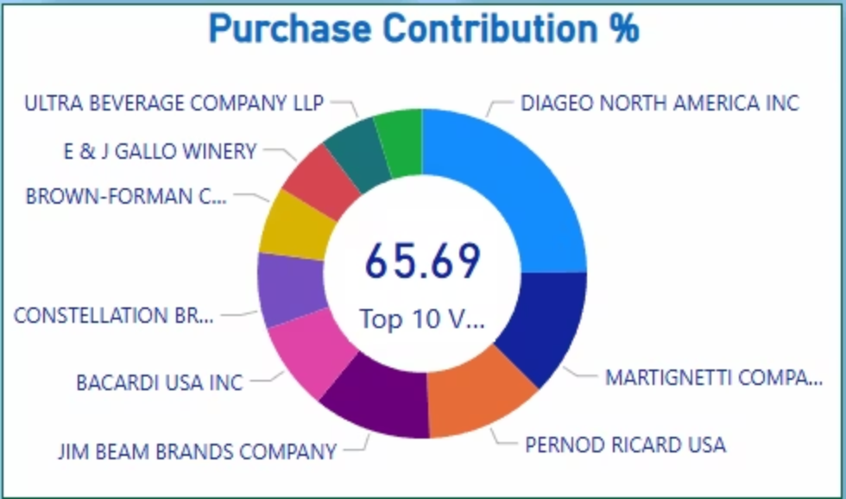
Purchase Contribution Analysis
Vendor Concentration Risk
Top 10 vendors account for 65.69% of total purchases, with Ultra Beverage Company leading at 17% contribution.
Strategic Dependency
Negotiation Power
Heavy reliance on select vendors creates supply chain vulnerability.
Concentration provides leverage for better terms with key suppliers.

Slide 5
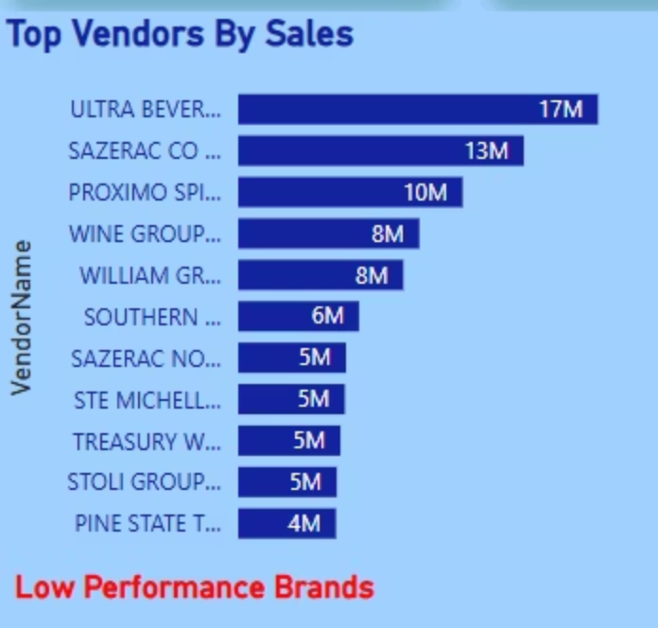

Top Revenue-Generating Vendors
Sales Leadership
Ultra Beverage leads with $17M in sales, followed by Sazerac Company at $13M and Proximo Spirits at $10M.
These vendors are critical to revenue stability and require continued partnership investment to maintain growth trajectory.

Slide 6
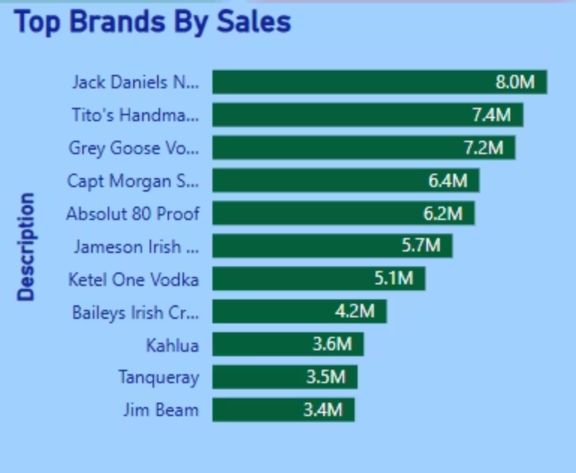
Brand Performance Leaders
Jack Daniels leads brand sales at $8.0M, followed closely by Tito's Handmade at $7.4M and Grey Goose at $7.2M. These premium brands demonstrate strong consumer preference and market positioning.
Brand strength directly supports overall sales performance, with top 11 brands generating significant revenue concentration.

Slide 7
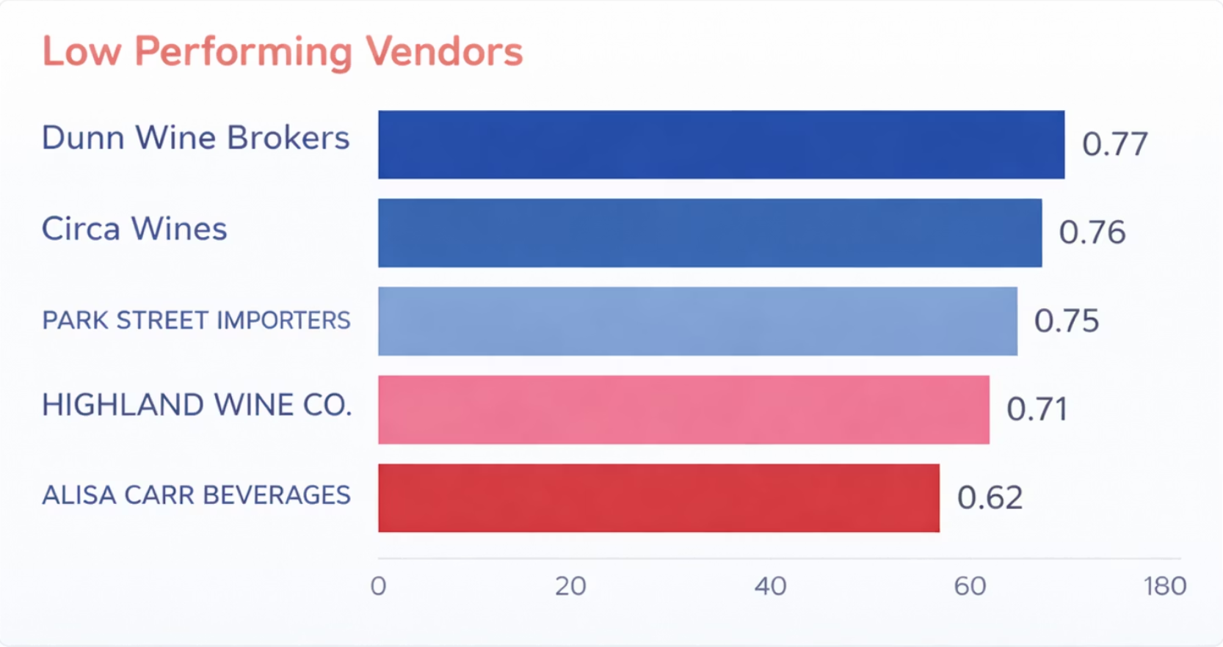
Vendor Efficiency Concerns
Low Performance Vendors
Five vendors show performance scores below 0.80, with Alisa Carr Beverage at 0.62 representing the lowest efficiency.
01
02
03
Performance Review
Contract Renegotiation
Portfolio Optimization
Conduct detailed analysis of underperforming vendor relationships
Establish improved terms or consider alternative suppliers
Replace consistently low performers to improve overall efficiency

Slide 8
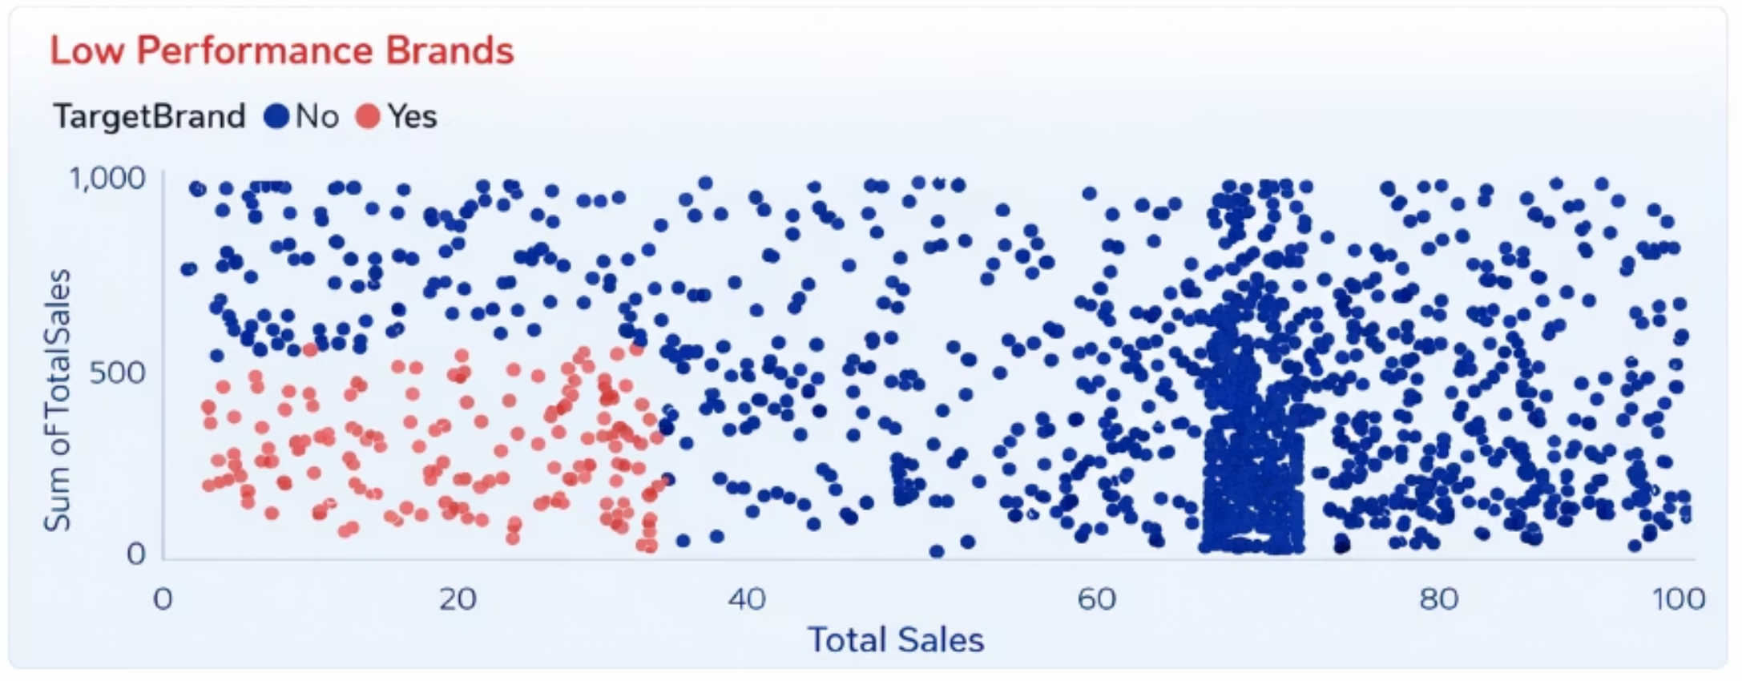
Brand Performance Distribution
Sales vs. Performance Analysis
The scatter plot reveals significant variation in brand performance across sales volumes. Many brands show low sales despite market presence, indicating underutilization or market fit issues.
Target brands (highlighted in red) demonstrate concentrated performance at lower sales levels, suggesting need for strategic repositioning or portfolio rationalization.

Slide 9



STRATEGIC RECOMMENDATIONS
Action Plan for Optimization
Vendor Optimization
Inventory Control
Brand Focus
Diversify supplier base to reduce concentration risk while maintaining strategic partnerships with top performers.
Reduce $2.71M unsold capital through improved demand forecasting and inventory management systems.
Concentrate resources on high-margin, high-volume brands while evaluating underperforming portfolio elements.
These strategic initiatives will strengthen vendor relationships, improve working capital efficiency, and drive sustainable profitability growth through data-driven decision making.

